Slide 1

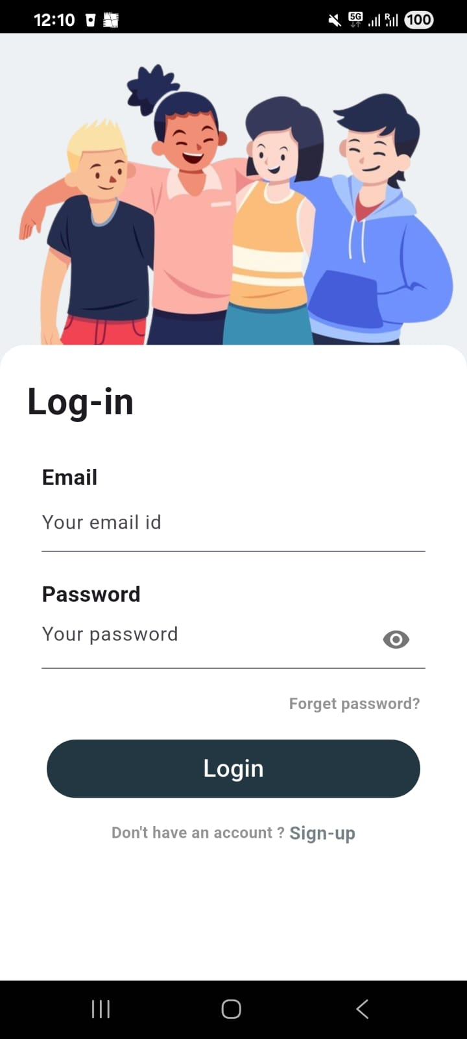
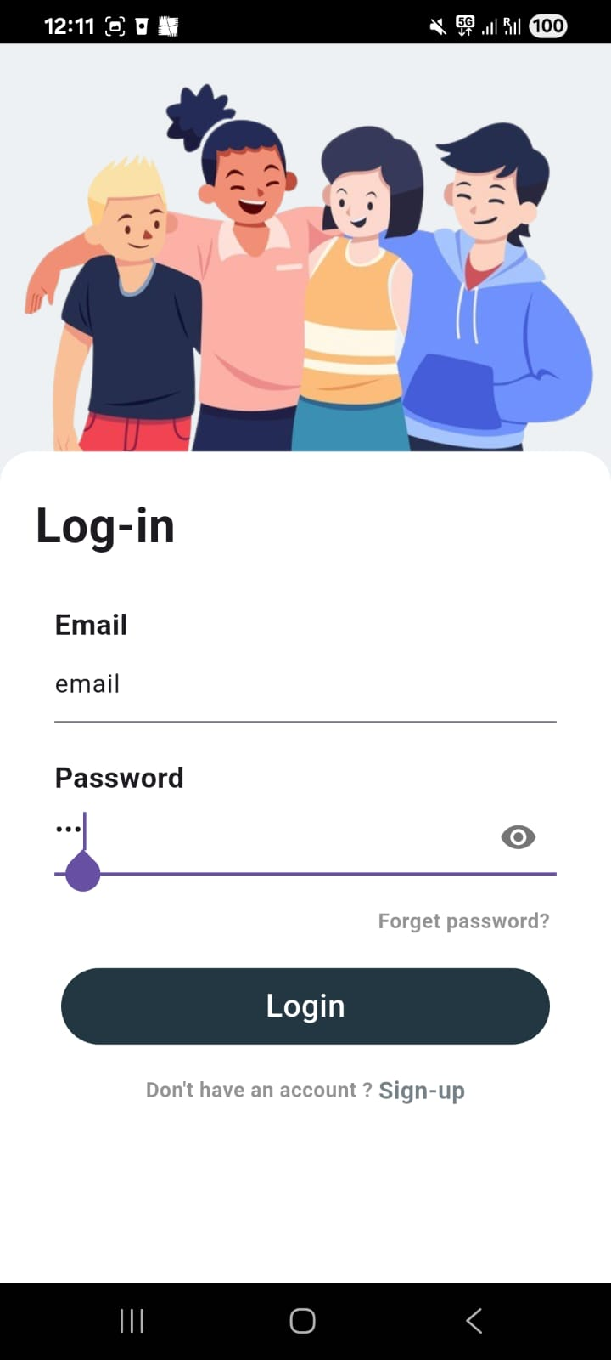
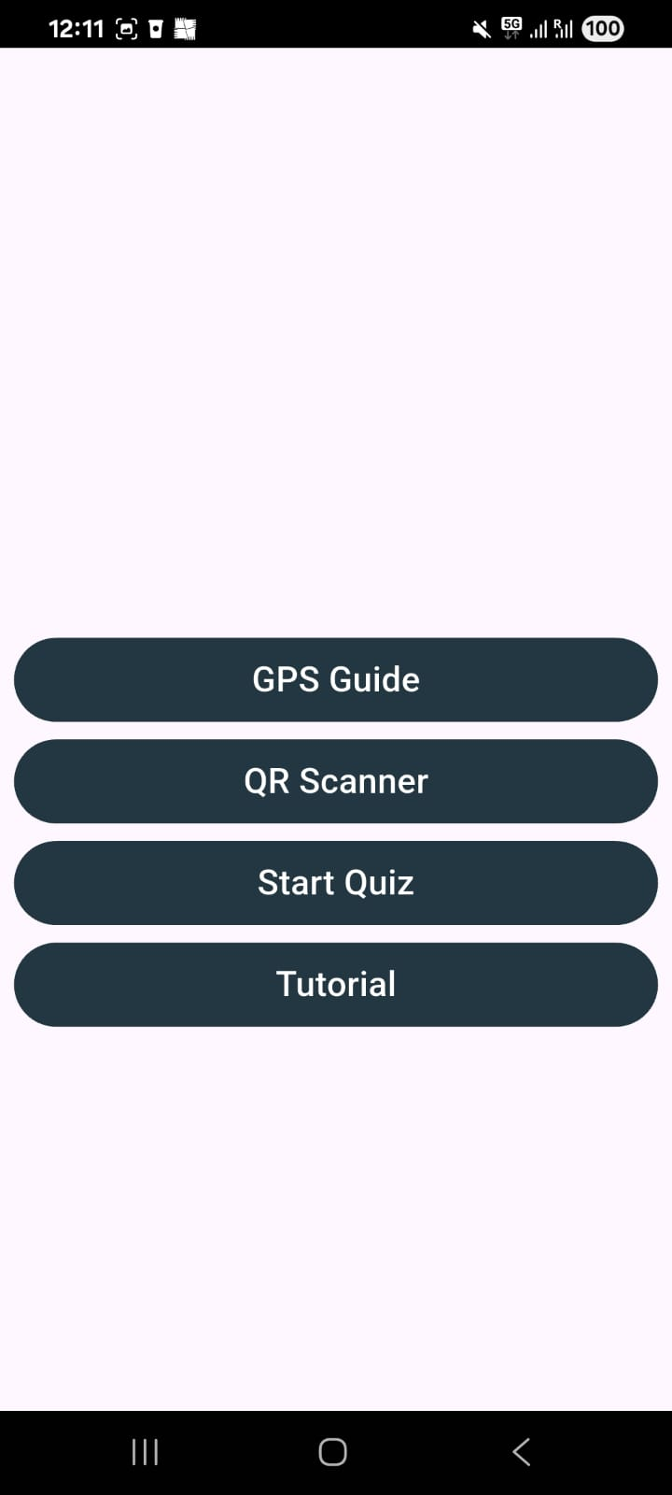
(a)
(b)
(c)
(d)

Slide 2
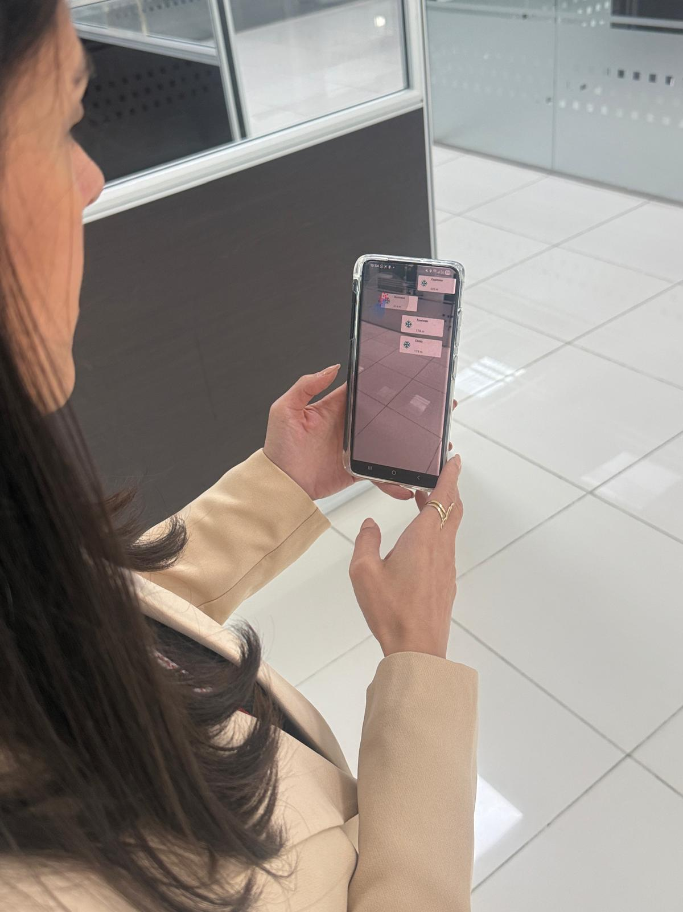
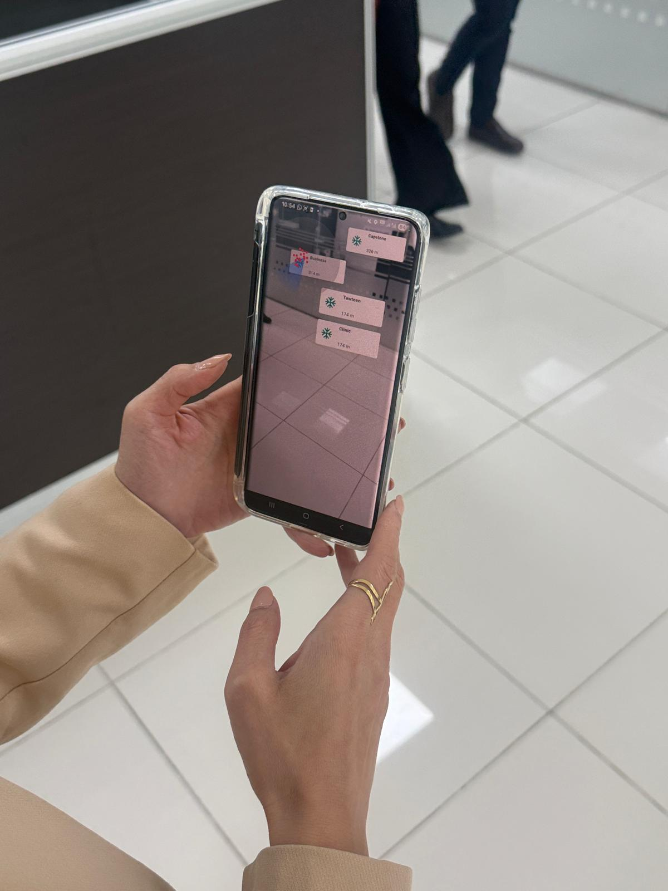
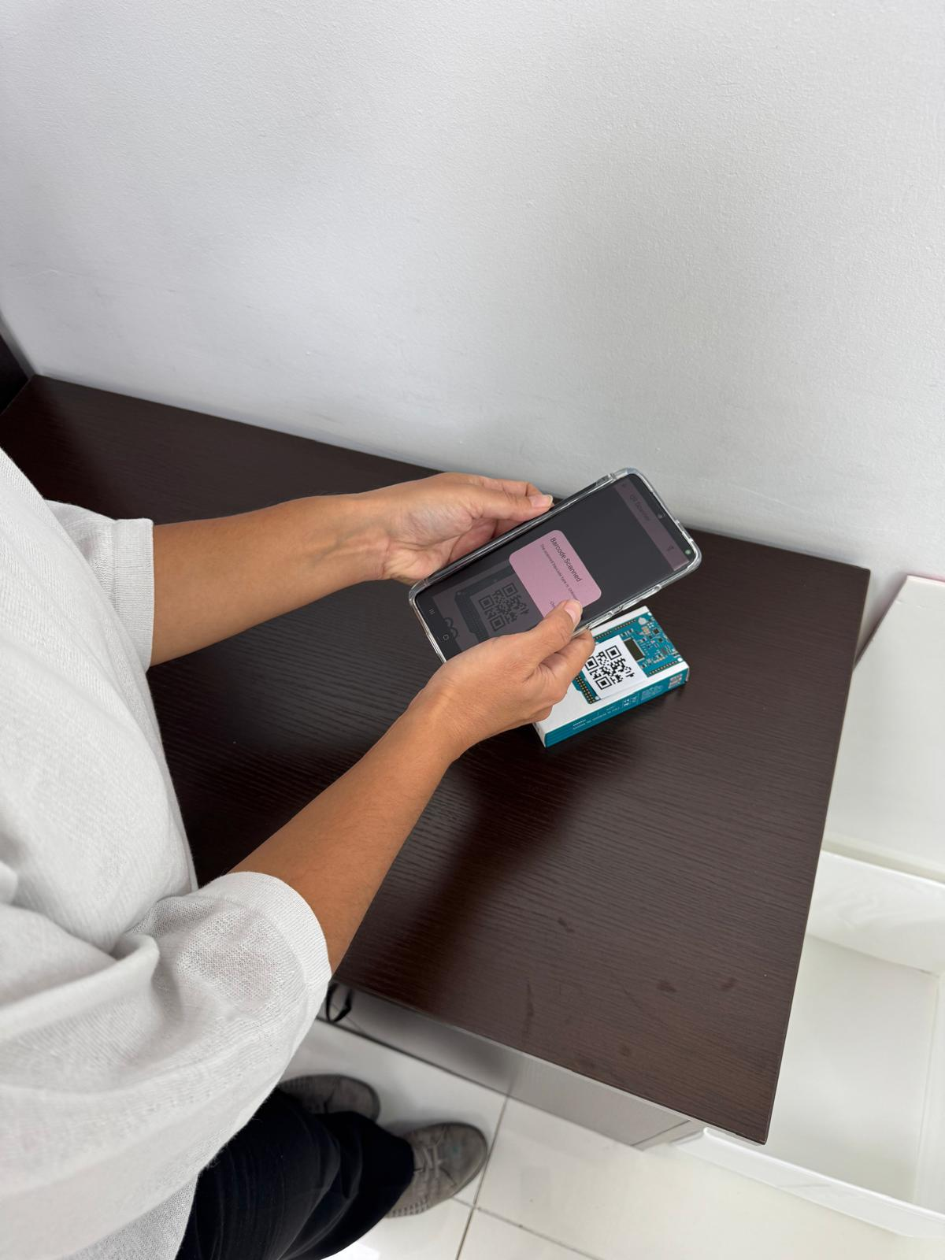
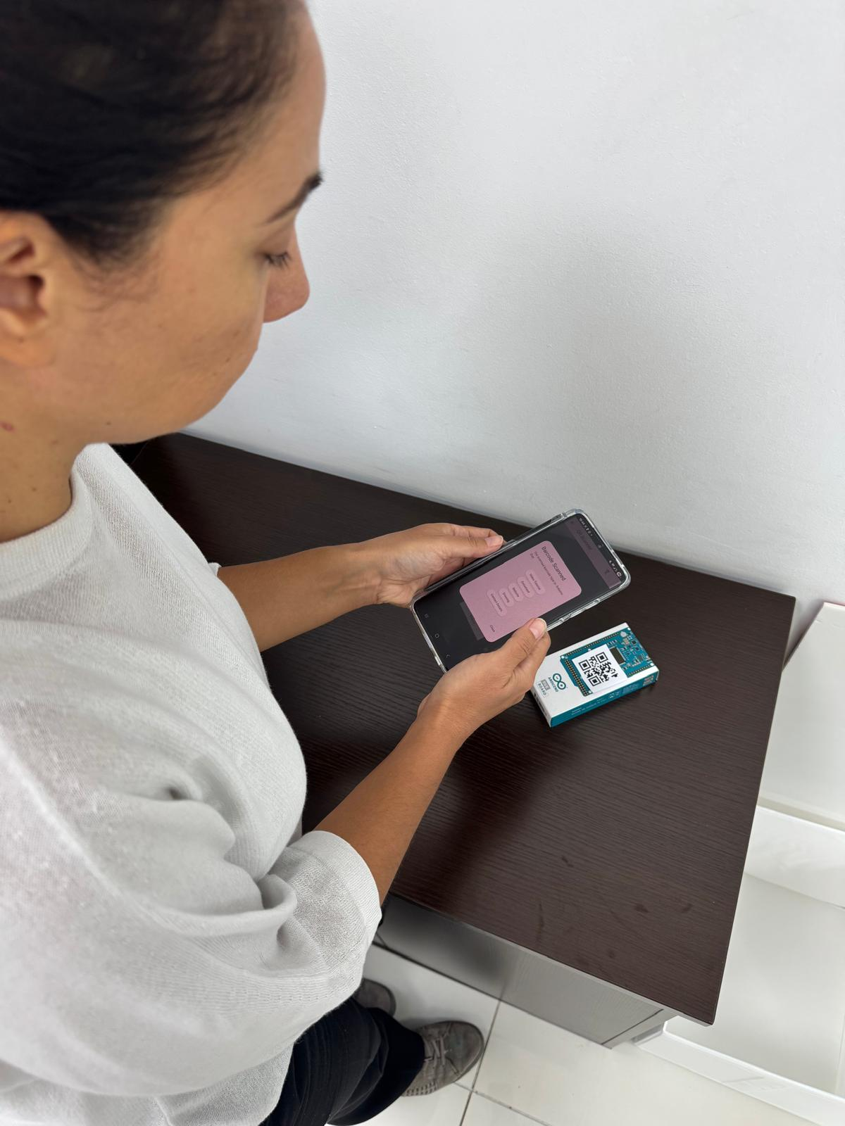
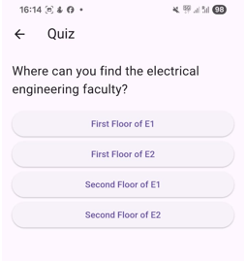
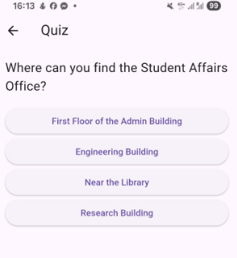
(a)
(b)
(c)
(d)
(e)
(f)

Slide 3
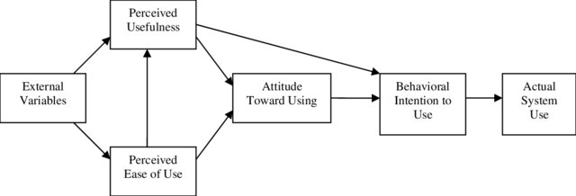
• H1: PEOU has a positive effect on PU.
• H2: PU has a positive effect on ATU.
• H3: PEOU has a positive effect on ATU.
• H4: ATU positively influences BIU.
• H5: PU positively influences BIU.
• H6: BIU positively AU.
Perceived Usefulness
H₂
H₅
External Variables
Attitude Toward Use
Behavioural Intention to Use
H₆
Actual System Use
H₄
H₁
Perceived Ease of Use
H₃

Slide 4
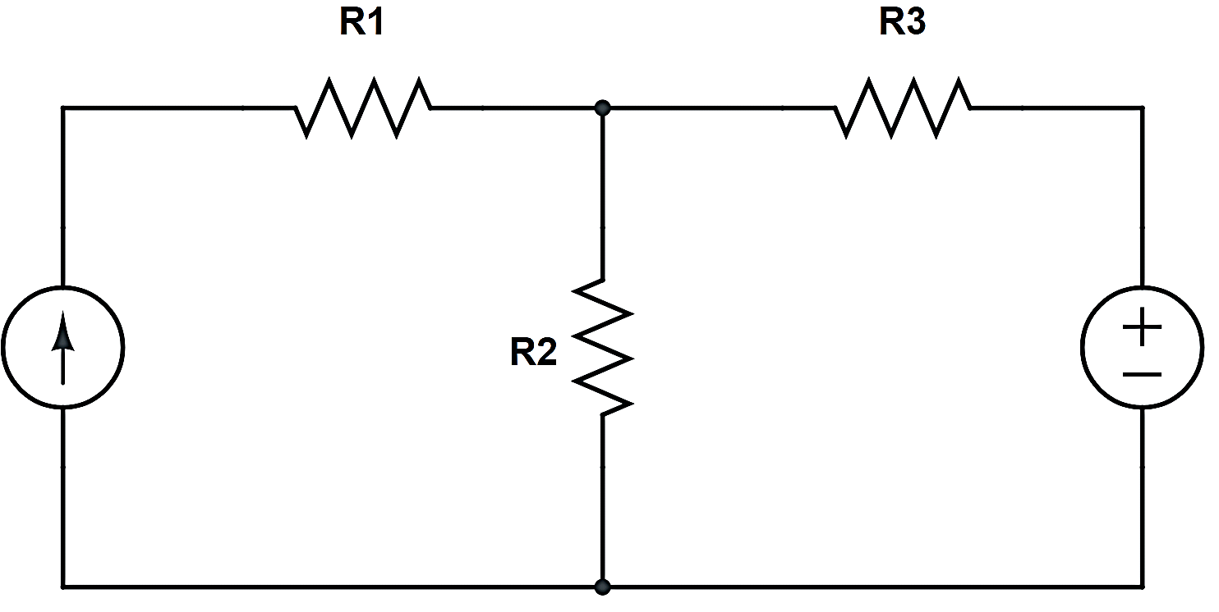
1

Slide 5
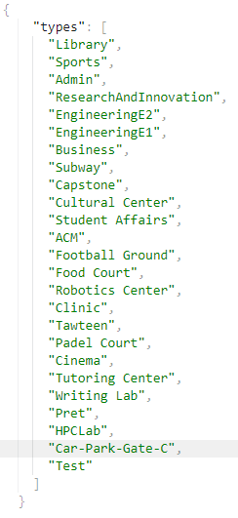
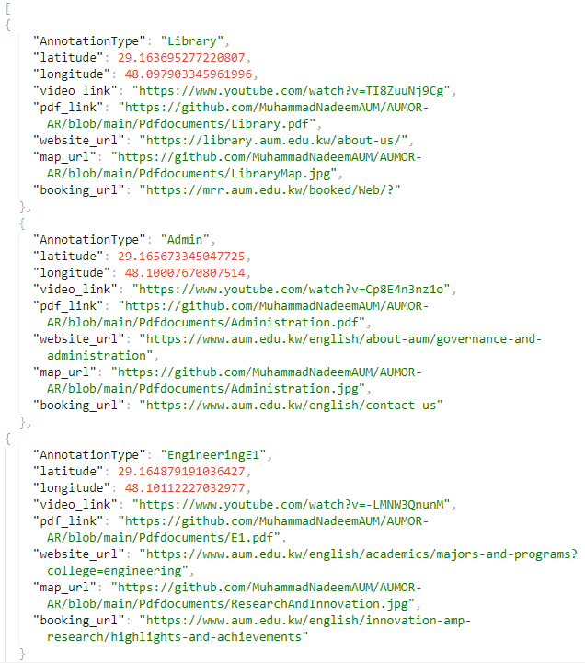
(a)
(b)

Slide 6

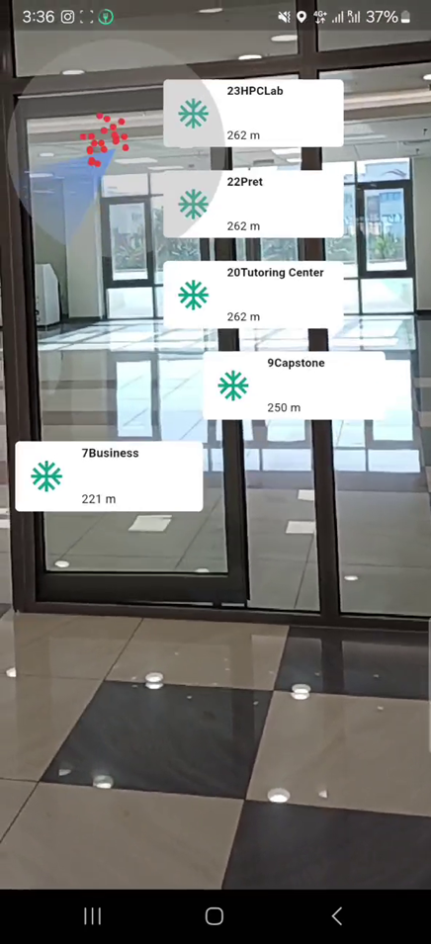
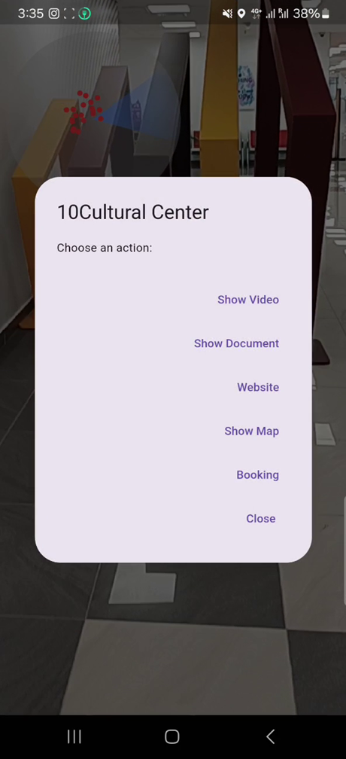
(a)
(b)
(c)

Slide 7
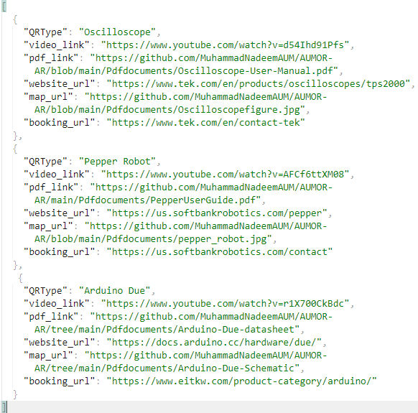
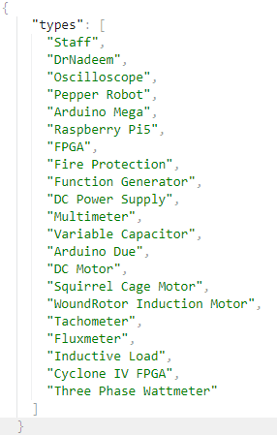
(a)
(b)

Slide 8



Slide 9
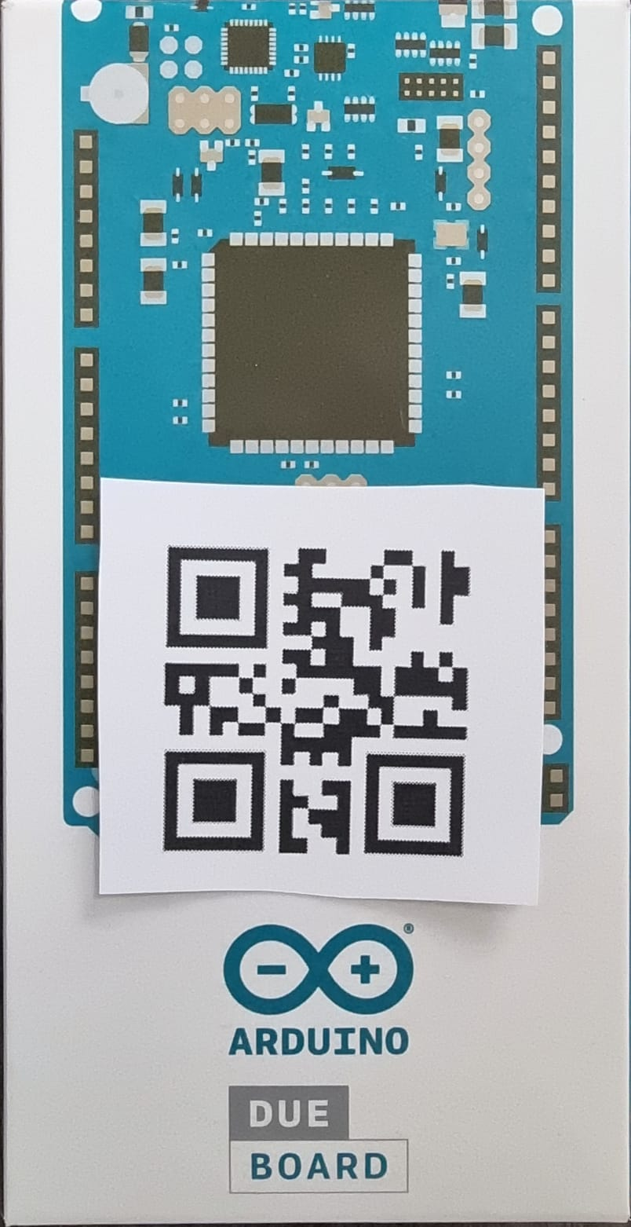
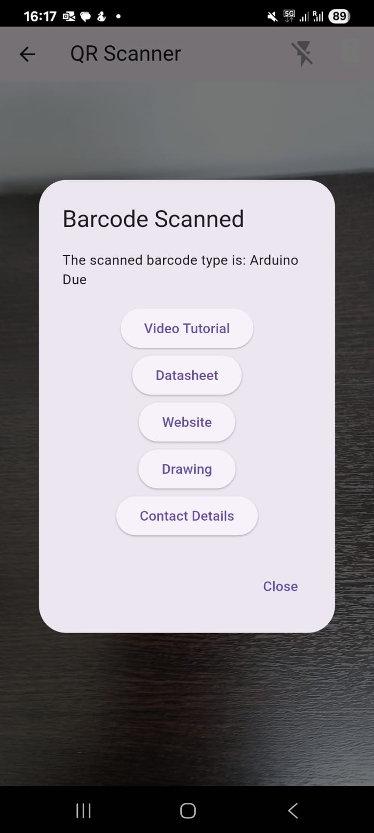
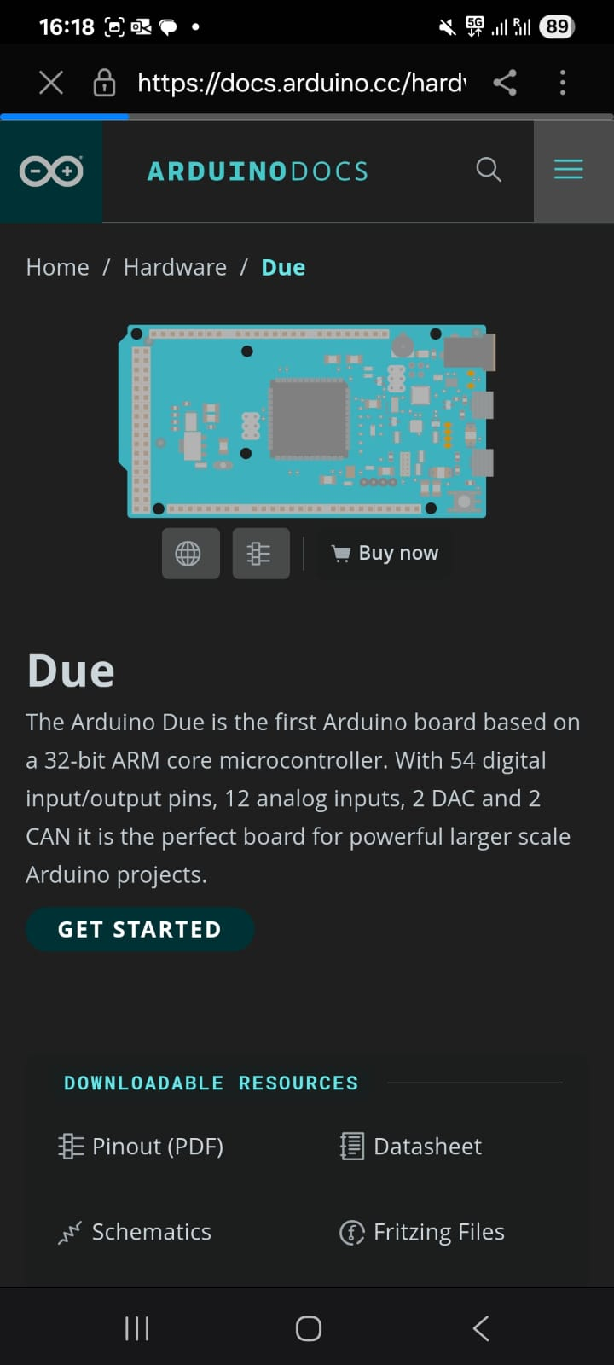
(a)
(b)
(c)

